Slide 1
Definitions
Long rains are calculated over dekad 7 to 21 for the agricultural areas and between 4 and 19 for rangelands areas. (EAR1)
Short rains from dekad 29 to 4 for the agricultural areas and between 25 and 4 for the rangeland. (EAR2)
In the following EAR1 is the long rains / EAR2 short rains

Slide 2
Rainfall

Slide 3
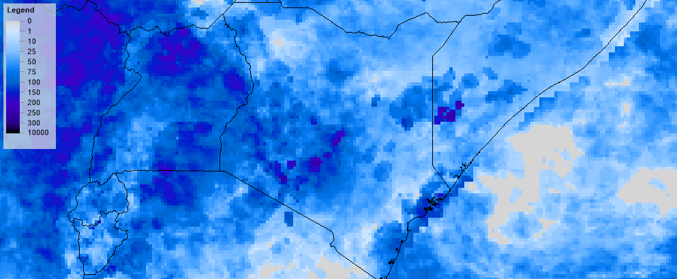
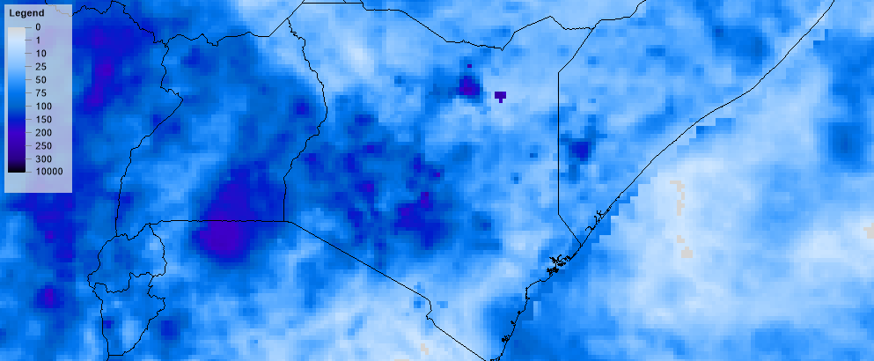
ARC rainfall from 21st April to 1st May 2018
REF2 rainfall from 21st April to 1st May 2018

Slide 4
WRSI

Slide 5
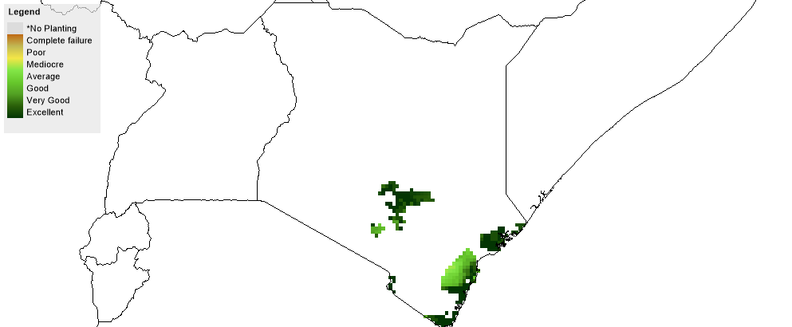
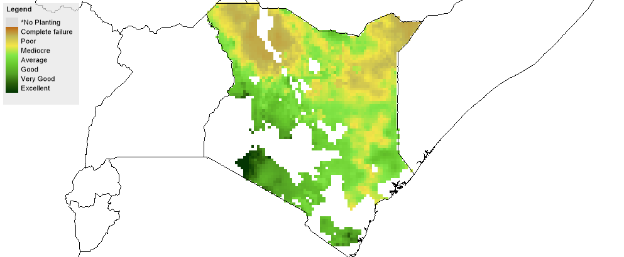
WRSI for maize areas that are ‘insured’ during EAR1 for 2018 (ie. so far)
WRSI for rangelands that are ‘insured’ during EAR1 for 2018 (ie. so far)

Slide 6
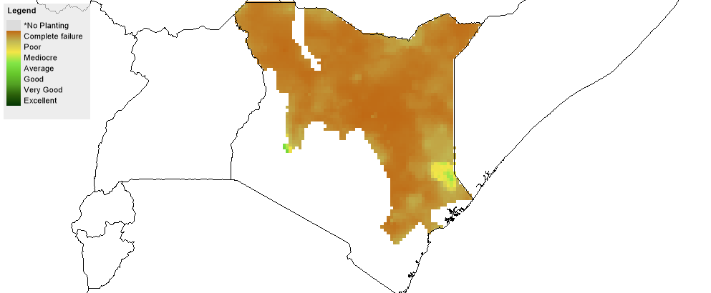
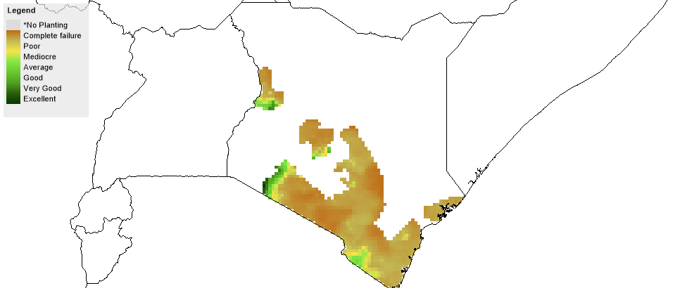
WRSI for arid rangelands that are ‘insured’ during EAR1 for 2018 (ie. so far)
WRSI for semi-arid rangelands that are ‘insured’ during EAR1 for 2018 (ie. so far)

Slide 7
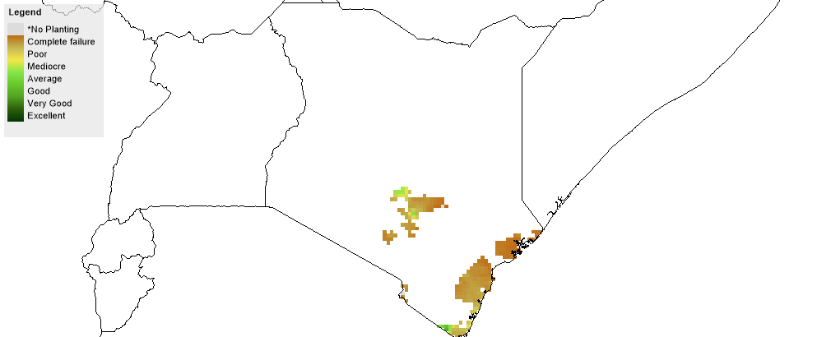
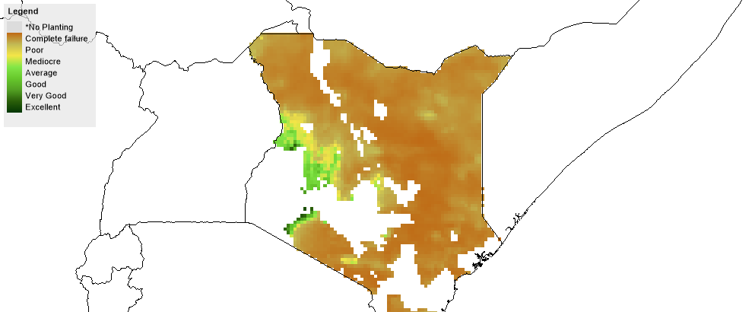
WRSI for maize areas that are ‘insured’ during EAR2 for 2017/18
WRSI for rangeland areas that are ‘insured’ during EAR2 for 2017/18

Slide 8
Numbers affected

Slide 9
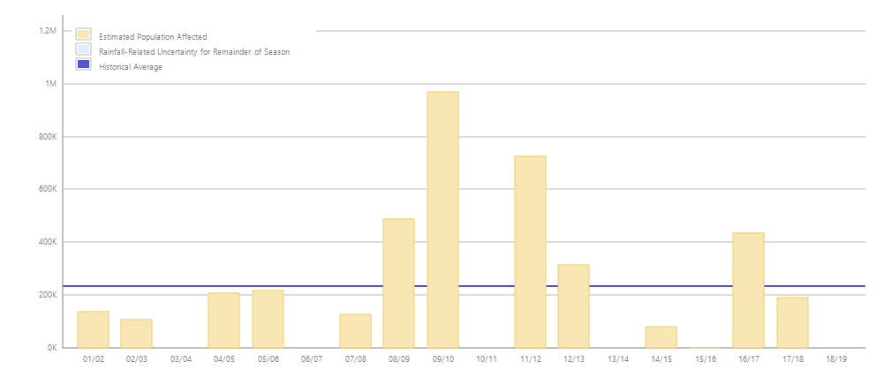
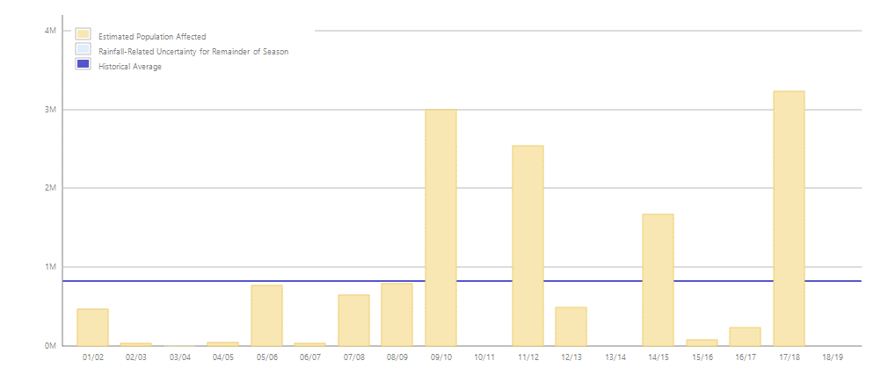
Numbers that are affected for maize areas that are ‘insured’ during EAR1 for 2018 (ie. so far)
Numbers that are affected for rangelands that are ‘insured’ during EAR1 for 2018 (ie. so far)

Slide 10
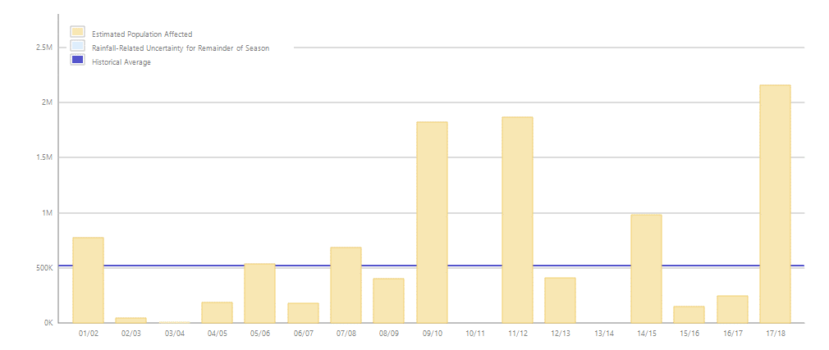
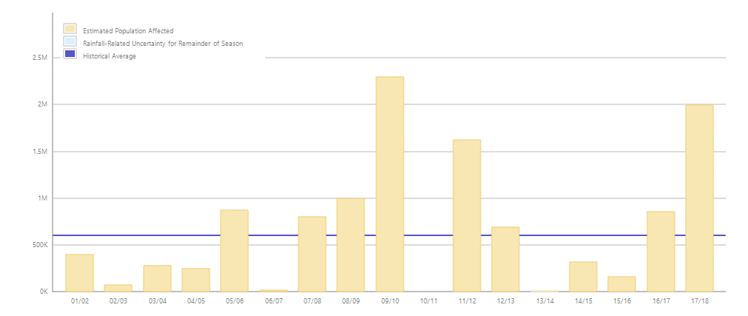
Numbers that are affected for arid rangelands that are ‘insured’ during EAR1 for 2018 (ie. so far)
Numbers that are affected for semi-arid rangelands that are ‘insured’ during EAR1 for 2018 (ie. so far)

Slide 11
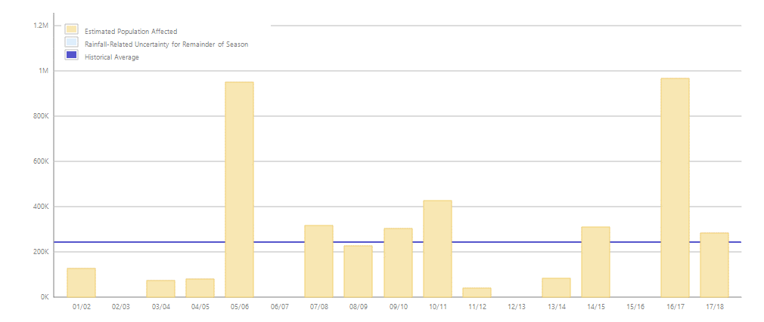
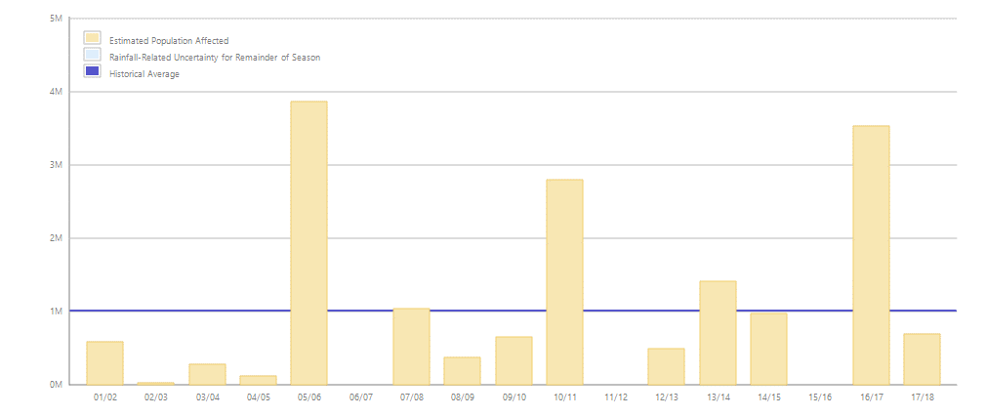
Numbers that are affected for maize areas that are ‘insured’ during EAR2 for 2017/18
Numbers that are affected for rangelands that are ‘insured’ during EAR2 for 2017/18

Slide 12
Predicted numbers affected as movie for EAR2 for maize

Slide 13
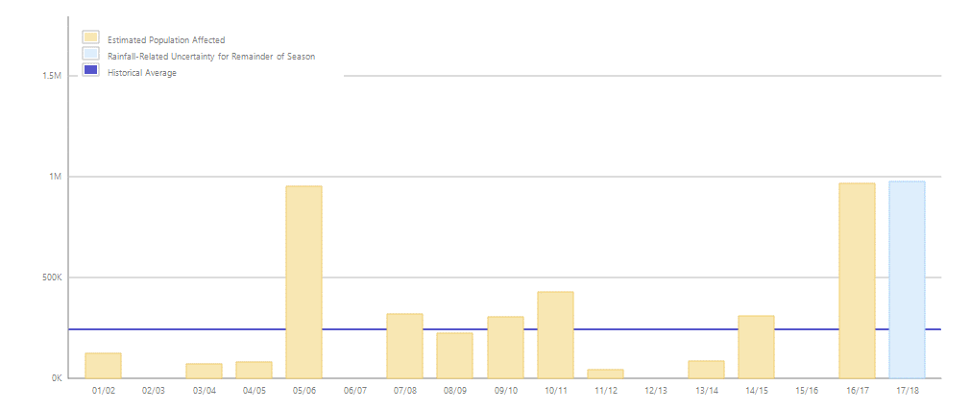
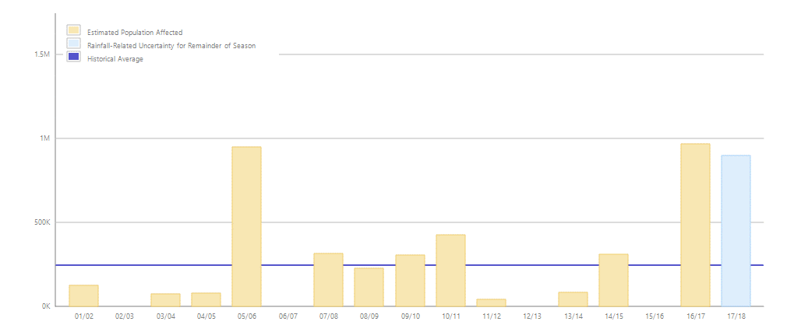
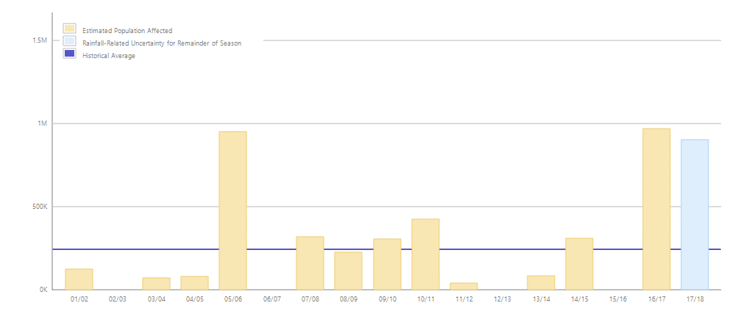
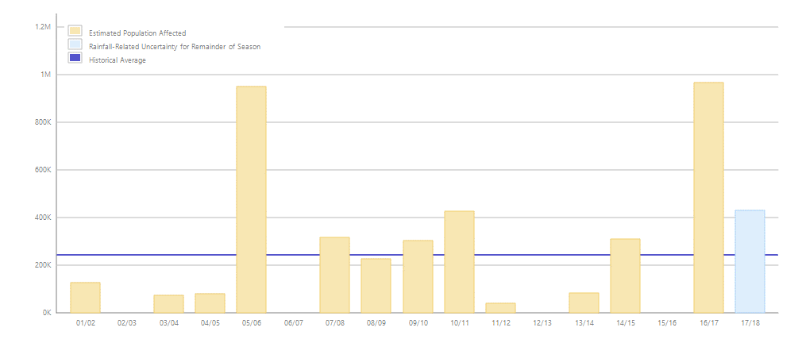
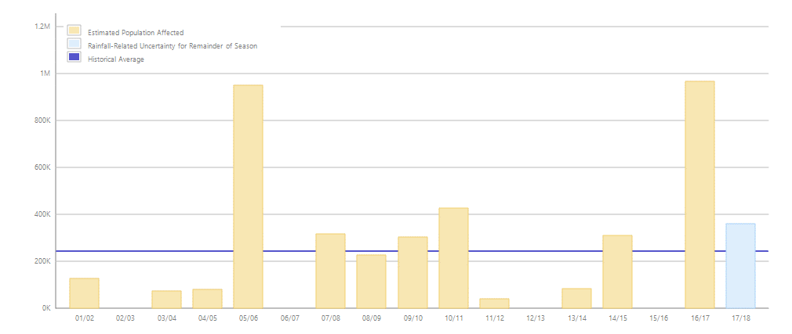
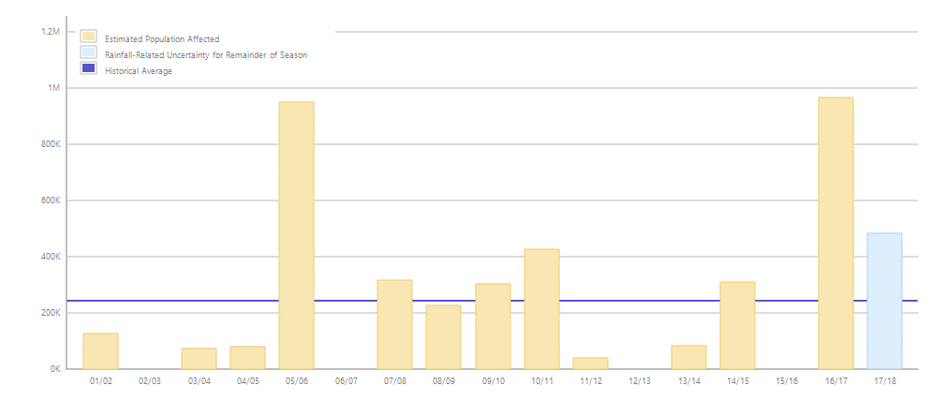
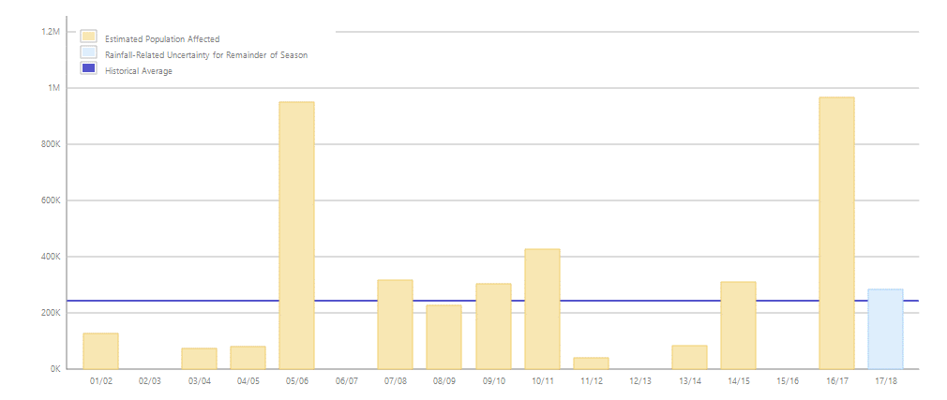
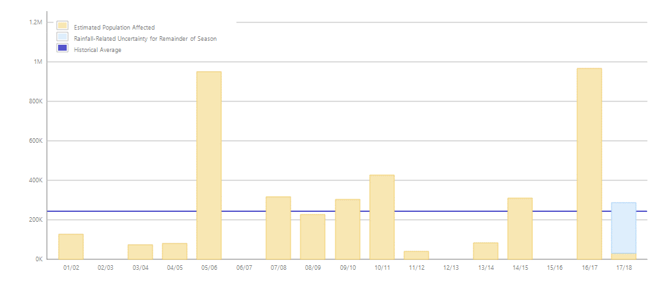
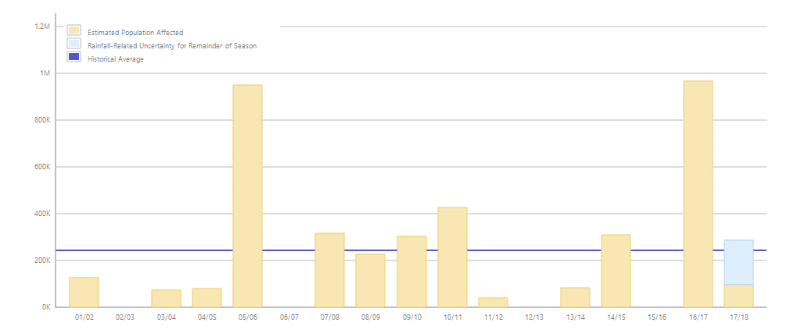



Numbers that are affected for maize areas that are ‘insured’ during EAR2 for 2017/18 from 1 Oct to 1^{1th} Feb

Slide 14
Response costs (example movies)

Slide 15
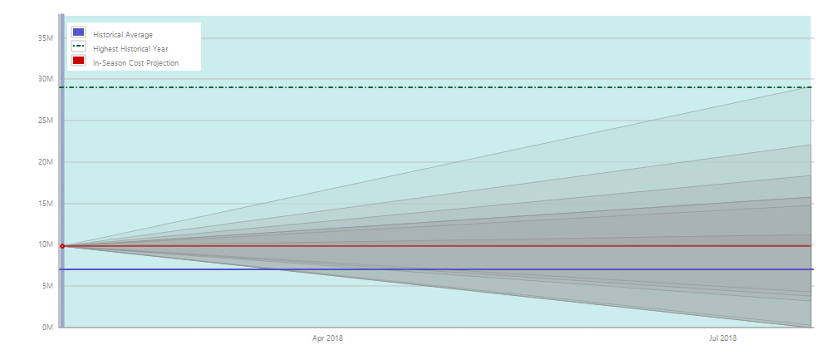
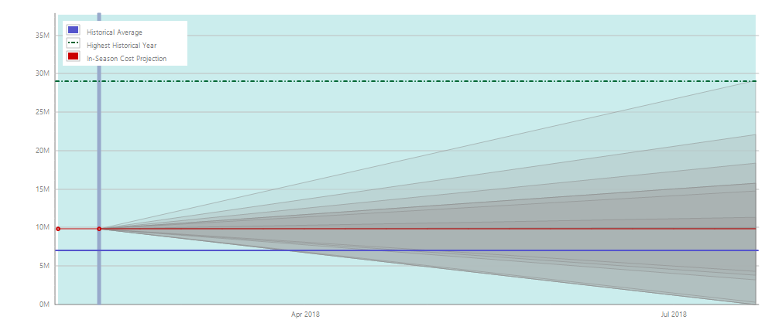
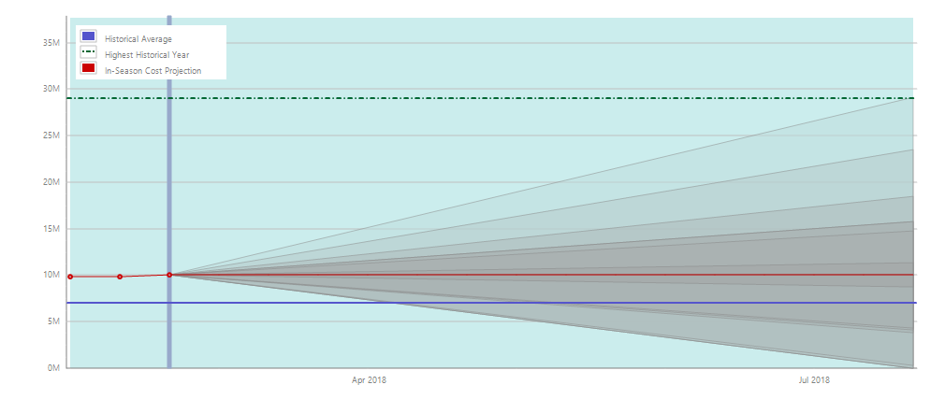
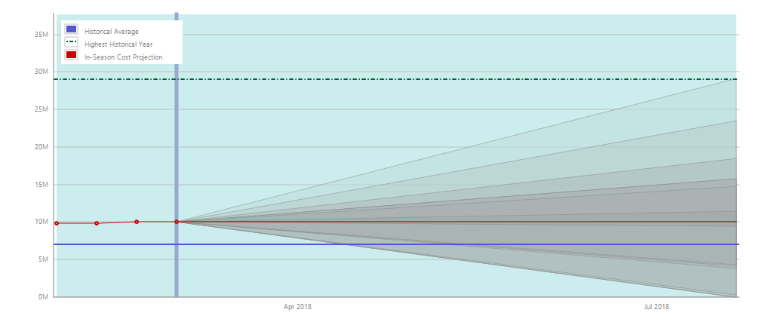
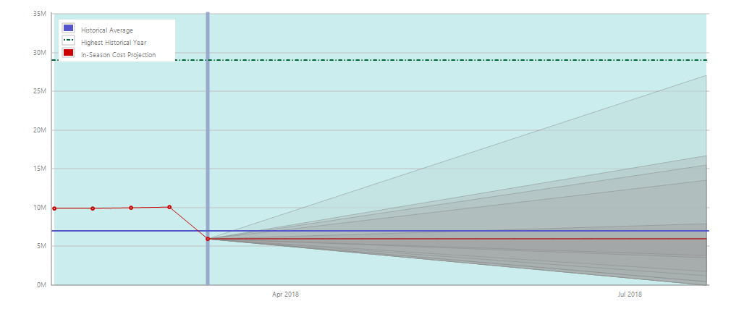
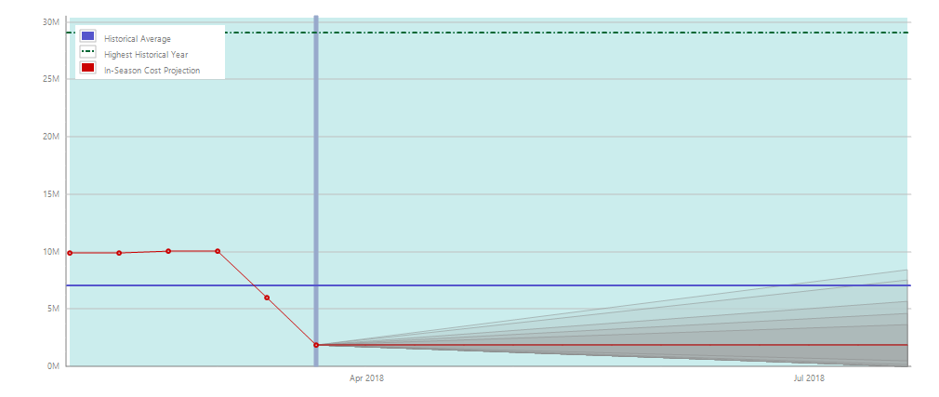
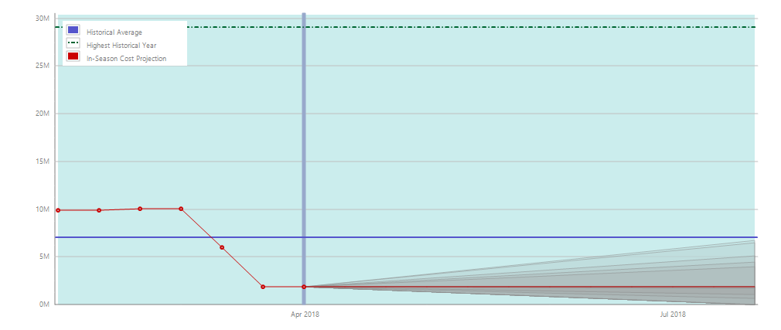
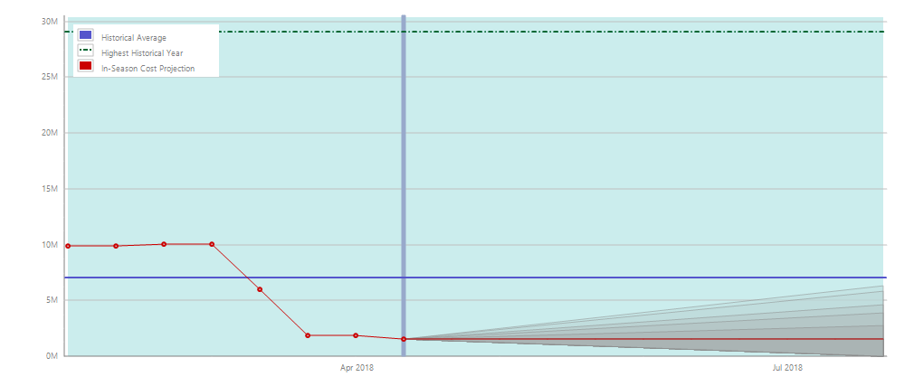
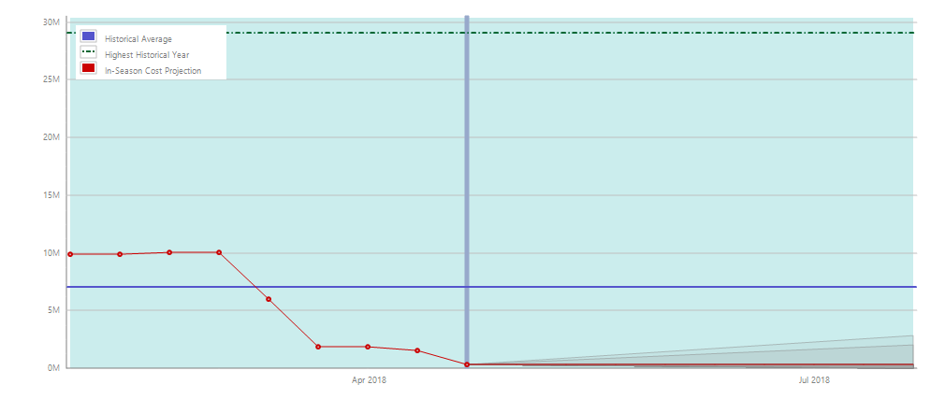
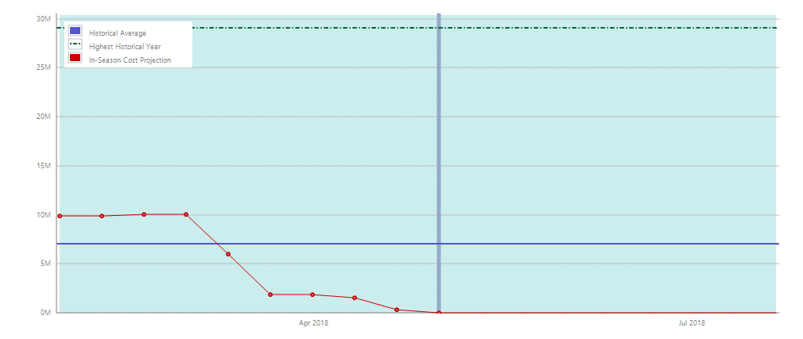
Response costs for maize areas that are ‘insured’ during EAR1 for 1 Feb to 1st May 2018 (ie. so far)

Slide 16
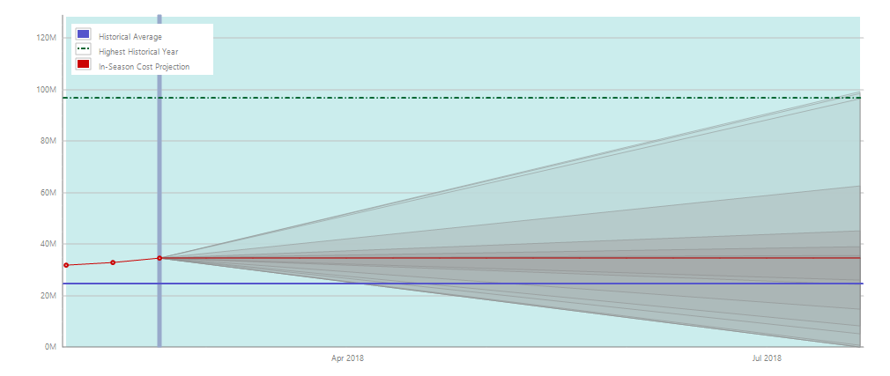
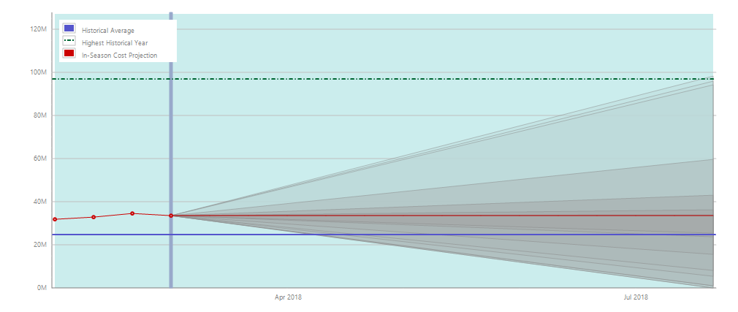
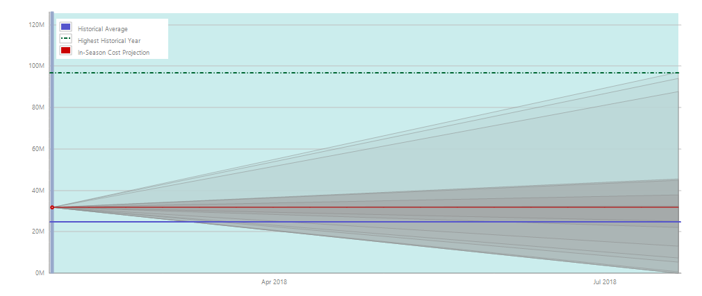
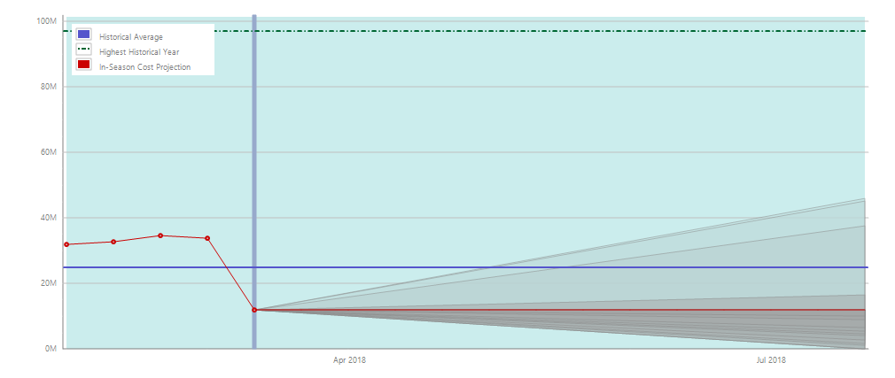
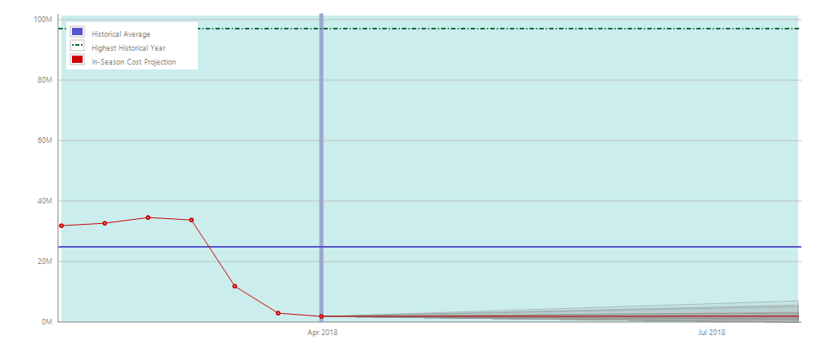
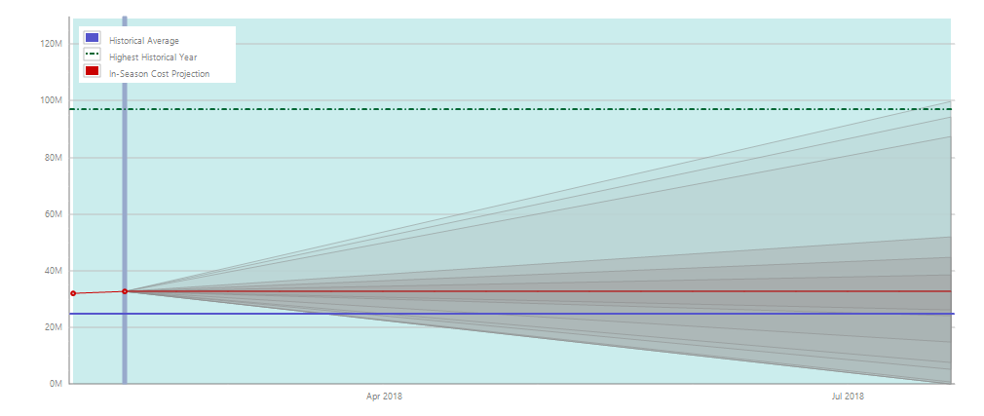
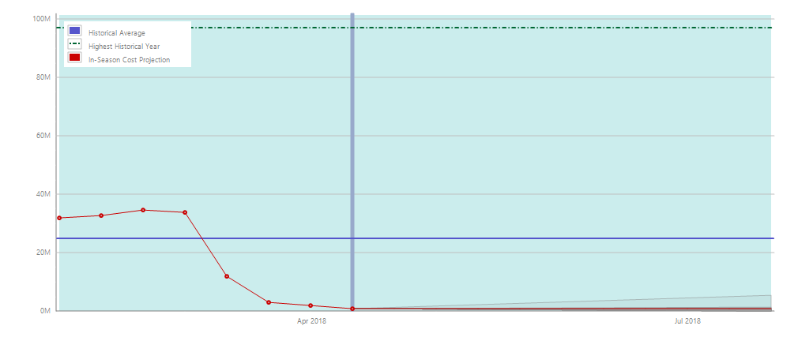
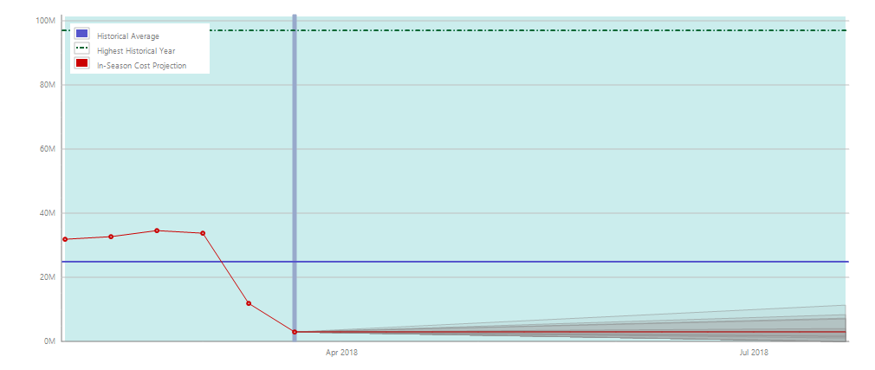
Response costs for rangelands that are ‘insured’ during EAR1 for 1 Feb to 1st May 2018 (ie. so far)

Slide 17
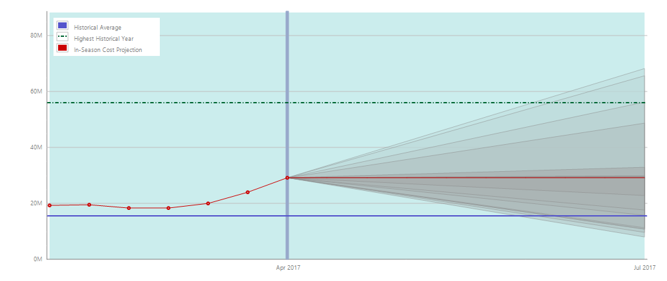
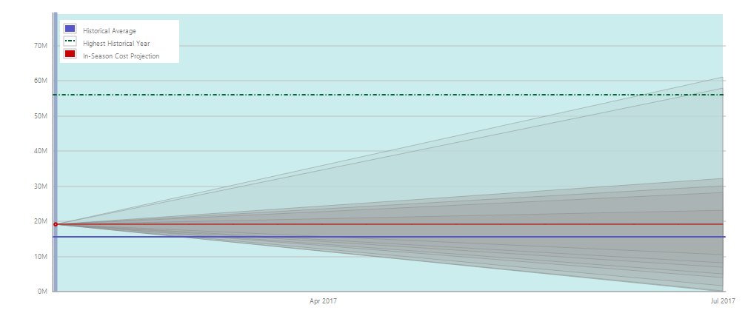
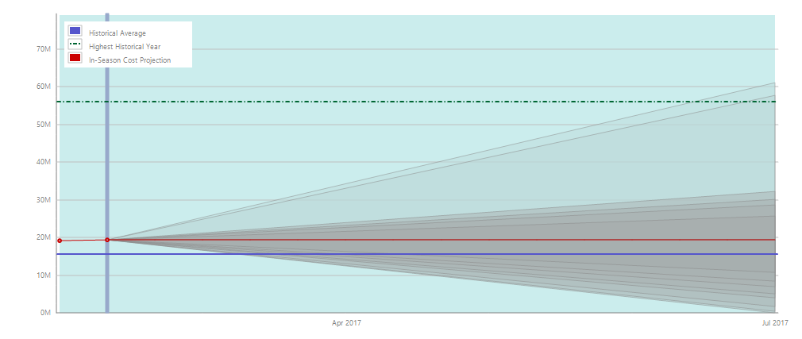

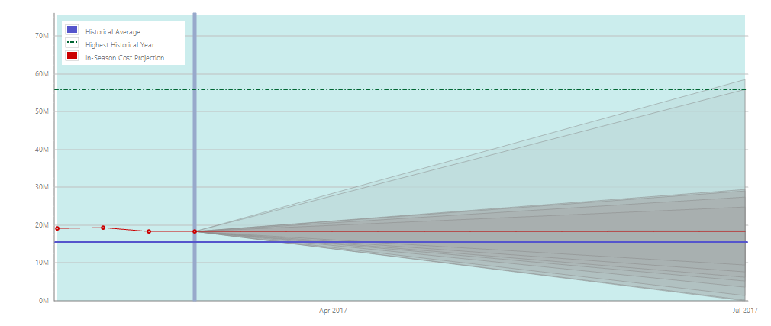
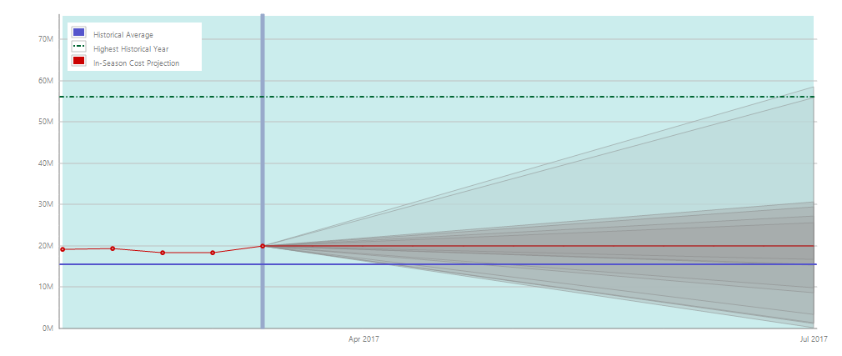
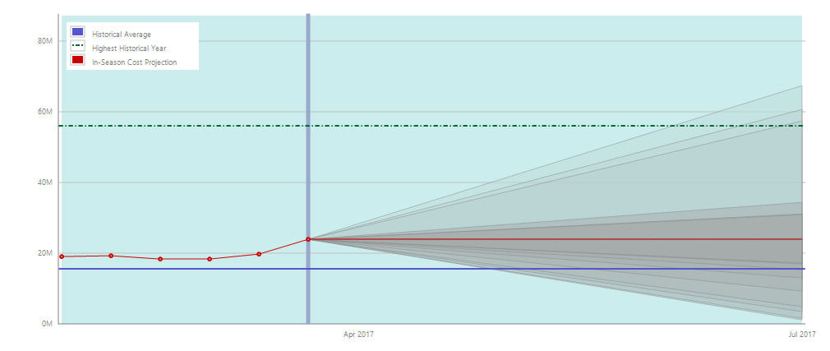
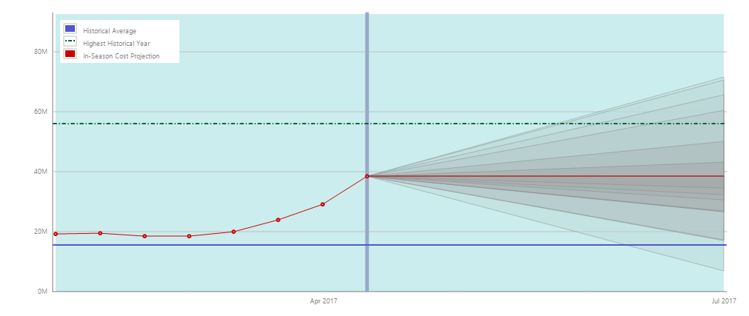
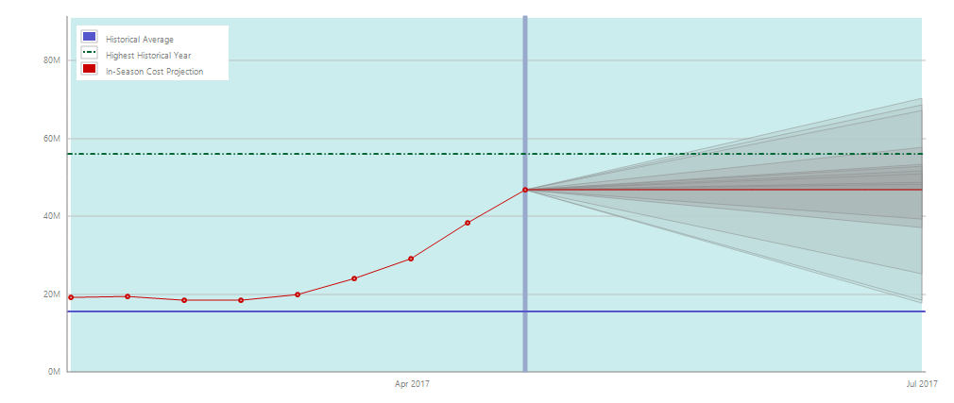
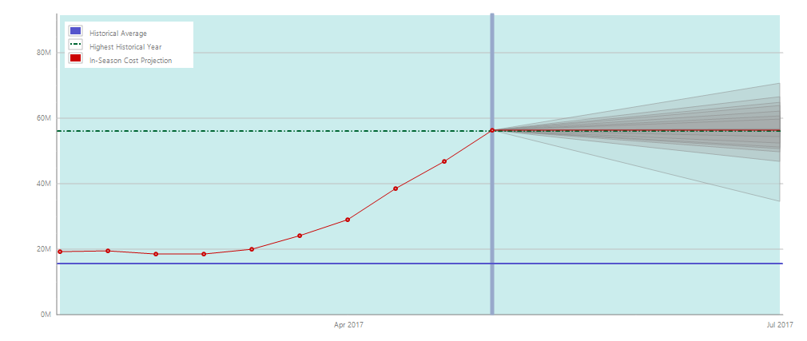


Slide 18

















Response costs for rangelands that are ‘insured’ during EAR2 for 1 Sep 17 to 11th Feb 2018

Slide 19
Parameters

Slide 20
EAR 1 Maize

Slide 21


Slide 22


Slide 23
EAR 1 Rangeland

Slide 24


Slide 25


Slide 26
EAR 1 Arid ranglend

Slide 27


Slide 28


Slide 29
EAR 1 Semi-arid rangeland

Slide 30


Slide 31


Slide 32
EAR 2 Maize

Slide 33


Slide 34


Slide 35
EAR 2 Rangeland

Slide 36


Slide 37


